Slide 1

Highest Grossing Movie Analysis (2008-2018)
Group Members:
Veronica Hamilton Mary Whistler
Grant Leach Nathan Prows

Slide 2
Core Hypothesis
We studied a data set of top grossing movies from 2008-2018 to determine correlation factors that contribute to overall gross earnings.
1. Are there any recurring themes of the plots of the highest grossing movies 2008-2018?
2. What actors and films returned the highest total worldwide gross movie sales?
3. What is the correlation between IMDB and Metacritic ratings and profitability?
4. What are the most profitable genres of each year?

Slide 3
Results and Findings
The questions we asked were simply points of interest for each of us as we looked through the available data set. Each of us were able to answer our questions based on the data set to our satisfaction. In some cases, an expanded data set would be beneficial to solidify the findings.

Slide 4
Data Cleanup & Exploration
Exploration and cleanup process
Insights
Data problems and how resolved
Discuss interesting figures

Slide 5
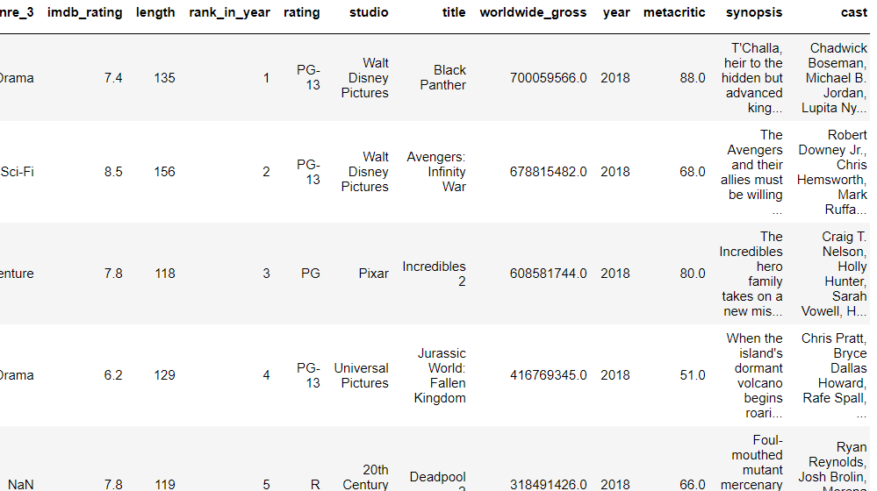
Data Analysis

Slide 6
1. Are there any recurring themes of the plots of the highest grossing movies 2008-2018?
Split data into list
Calculated word occurrences
Manipulate data
Findings

Slide 7

Recurring Plot Themes

Slide 8
2. What actors and films returned the highest total worldwide gross movie sales?

Slide 9
Top 10 actors based on average gross sales per movie, played in at least 2 movies
1. Zoe Saldana
Average worldwide gross: $1.3B
2. Michael Gambon
Average worldwide gross: $1.1B
3. Christian Bale: played in The Dark Knight and The Dark Knight Rises
Average worldwide gross: $ 1.0B
4. Johnny Depp played in 2 Pirates of the Caribbean
Average worldwide gross: $1.0B
The rest of the top 10 actors came from 2 movie franchises
Transformers and The Hobbit

Slide 10


Slide 11
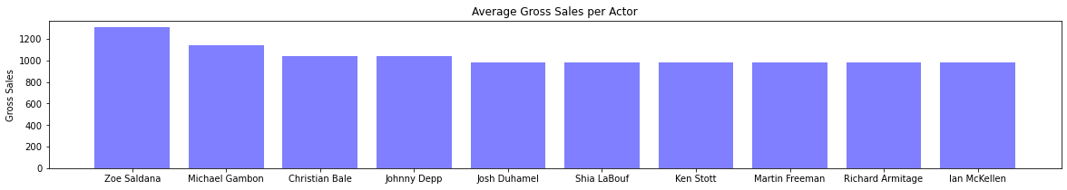
Top Grossing Actors

Slide 12


Slide 13
Top Grossing Movies
1. Avatar: $2.7B
2. The Avengers: $1.5 B
3. Harry Potter and the Deathly Hallows Part 2: $1.3B
Findings
Originally wanted to see if actors drove high sales but after analysis from this data it looks like the genre plays a bigger role in worldwide gross sales
Most of the movies in the top 10 were superhero movies or major movie franchises with sequels
We will take a closer look at genres later in the presentation.

Slide 14
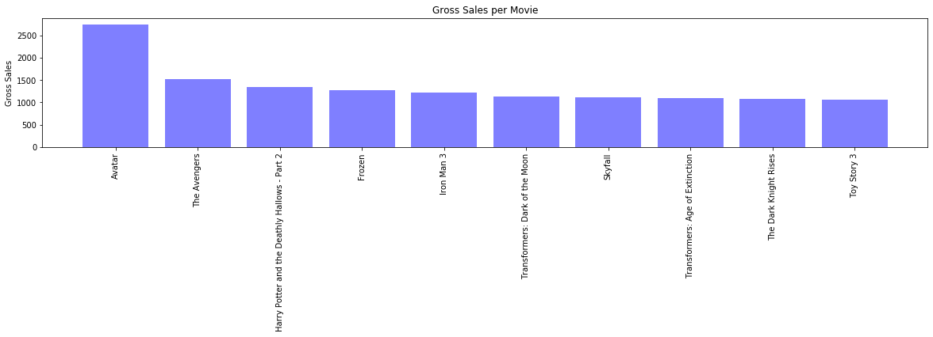
Top Grossing Movies

Slide 15
3. Which scoring model, if any, is most reflective of the financial success of the movie?
Ratings used/manipulated/cleanup
Scatterplot
Linear Regression
Charts and Correlations
Group by Earnings

Slide 16
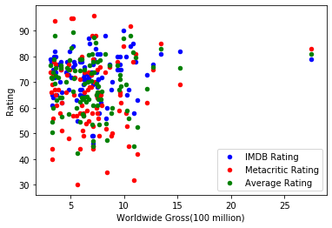
Scatter plot

Slide 17
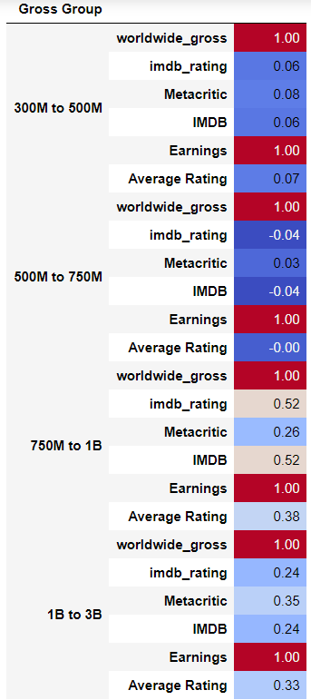
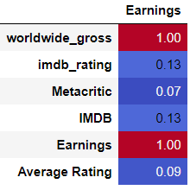
Correlation Data

Slide 18
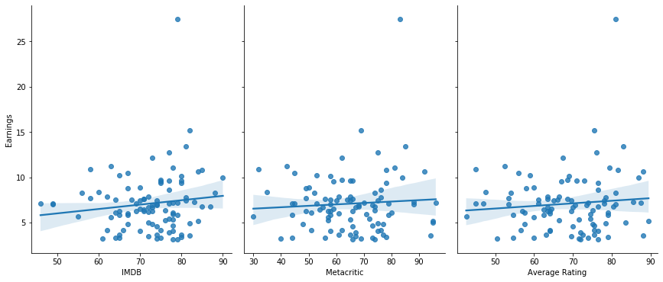
Linear Regression reveals?

Slide 19
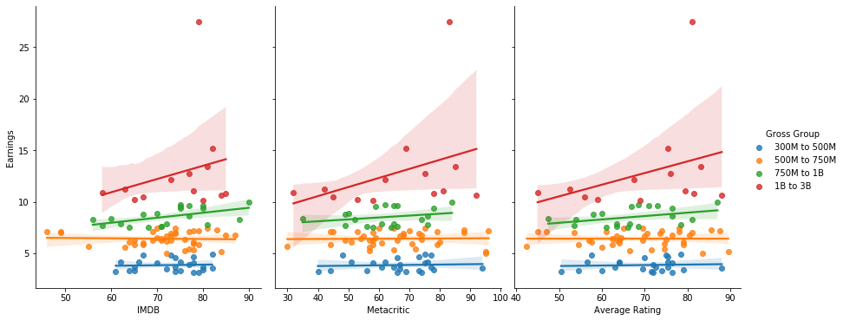
Linear Regression by Gross Group

Slide 20


Slide 21
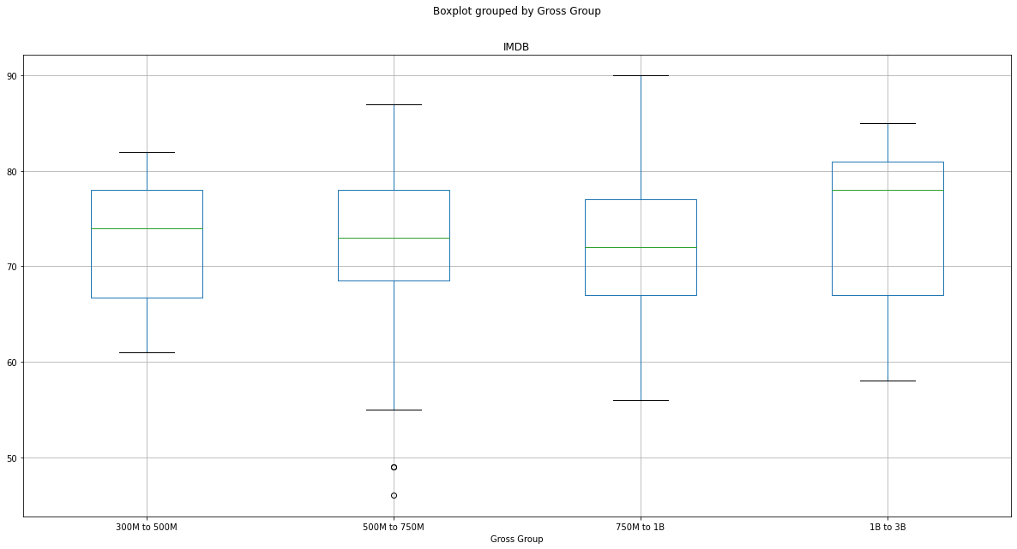

Slide 22
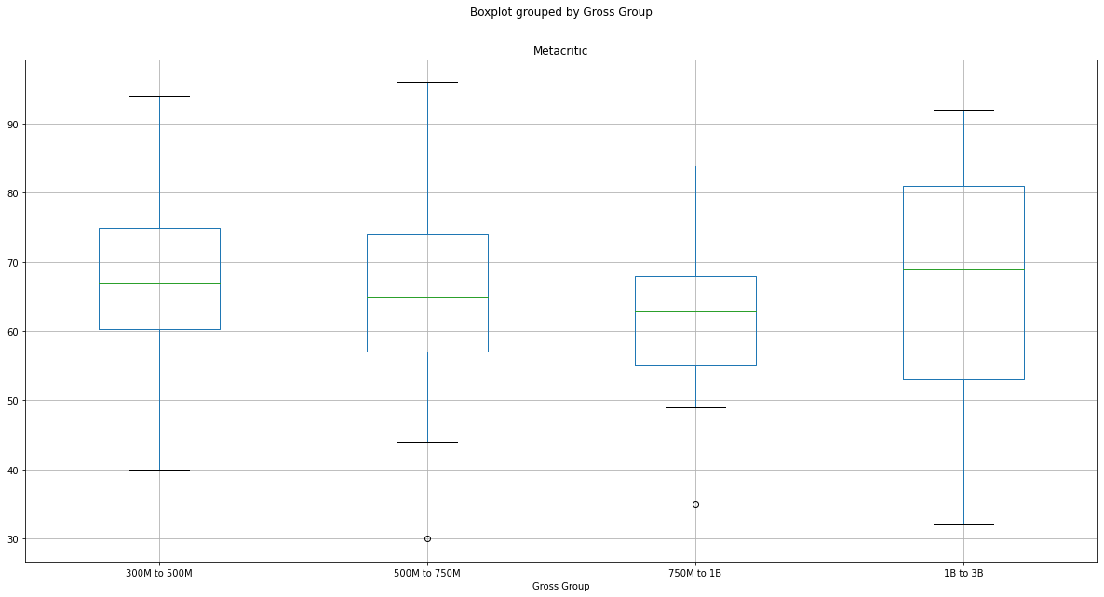

Slide 23
4. What are the most profitable movie genres?
Further data clean up to narrow down what we are looking at
Grouped data by genre and year, summed earnings
Also grouped by genre only to analyze overall success of each
Plotted data

Slide 24
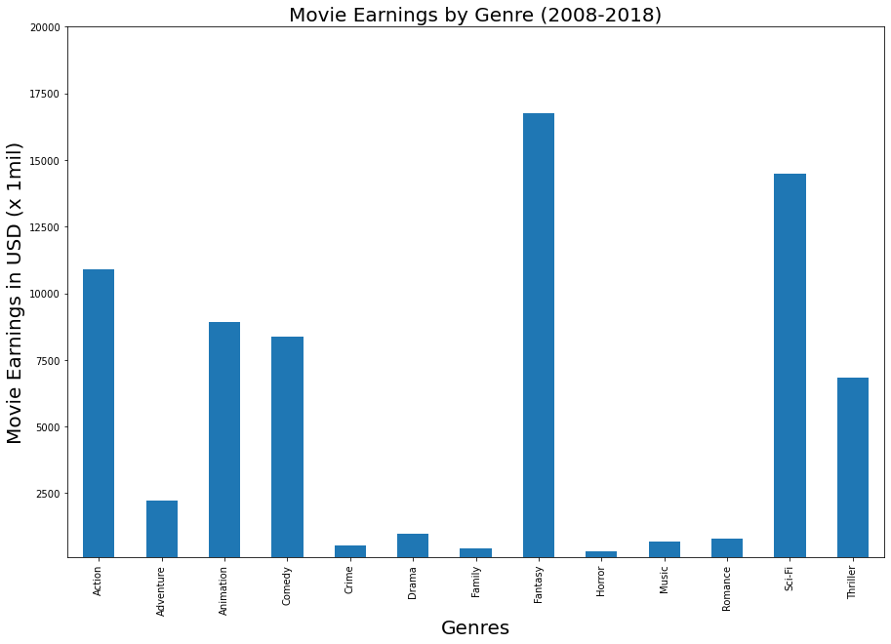
Overall, fantasy and sci-fi are the most profitable genres, while horror and family are the least profitable

Slide 25
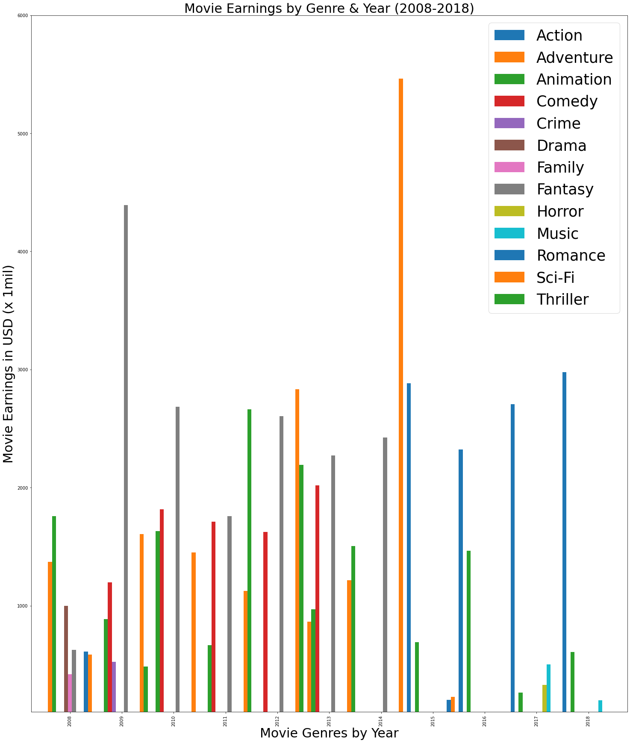
Doing a deeper dive and breaking out by year…

Slide 26
Adventure movies seemed to be rising in profitability before sharply declining
Later in the decade, we see action movies rising in profitability instead
Although fantasy was overall the winner for the decade, the profitability of the genre is also declining overall
We also see overall less “blockbuster” movies with mega-earnings as time goes on
Analysis

Slide 27
Postmortem: Failed Project
Lyric project scrapped
Already been done
Data set availability

Slide 28

Limitations
Data set was limited to 10 years
Many other factors to be studied
Ratings by genre
Time of year released
Influence of various types of marketing

Slide 29

Q&A

